Slide 1

Smart Stick to Avoid Obstacles for Visually Impaired
Notes:
Hello, my name is Hamza Afzal. Today I will be presenting you my project, which is a smart stick to avoid obstacles for visually impaired.
Visually impaired people are those, whose eyes can’t see objects due to visual acuity loss or they have a reduced visual field of view. This makes the movement of a person very difficult and
restricted. One of the most appropriate solutions to this problem is a Smart Stick. This is an improvement made on a traditional method of navigation for blind people. The stick is now equipped with modern technology. This includes a system which is based on Arduino Nano. The Arduino is coupled with Ultrasonic Sensor to identify the obstacles. The stick also comes with an SOS button, in which the user can press the button in an emergency and the location is sent to the pre-defined
mobile number. This is done using a GPS module and a GSM Module.

Slide 2
Project Aim and Objectives
Aims
  Economical
  Easy to Use
Objectives
  Obstacle Detection and Avoidance
  Location Tracking System
  Reliable and Safe
  Power Efficient
Notes:
Our First and foremost concern was to make this thing economical. Because there are a few competitors selling smart sticks in the market for over 300 pounds which include wewalk and ultracane.
Hence, we took this as a challenge to make something similar at a relatively much lower cost. In addition to this we aimed that we should make this product as easy to use as we can. There should be no requirement for a very hard training and a product should such that it is easy to use in start so that the user gets used to it overtime.
Initial objective of this project is to detect and help avoid obstacles.
We also will install a location tracking system so the user’s dedicated pupil is able to track them in case of emergency
Along with this Reliability is really important for a system especially in this case as we are talking about a visually impaired user.

Slide 3
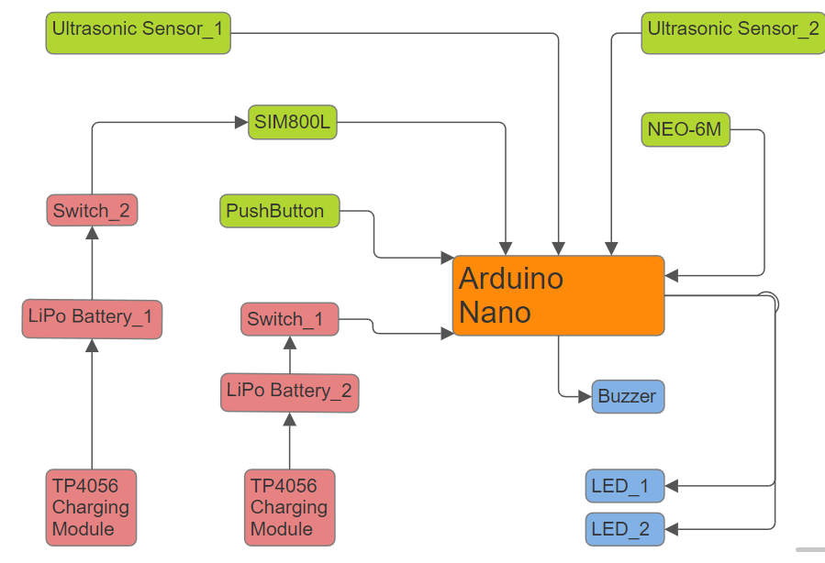
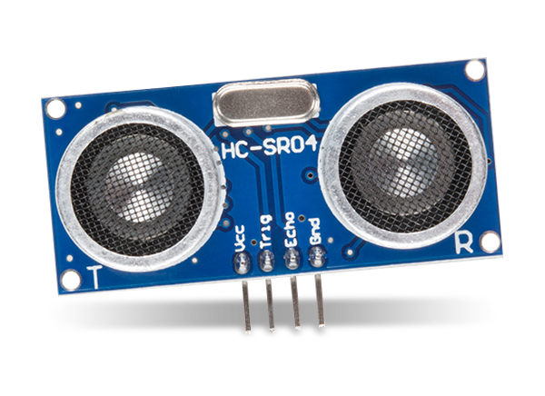
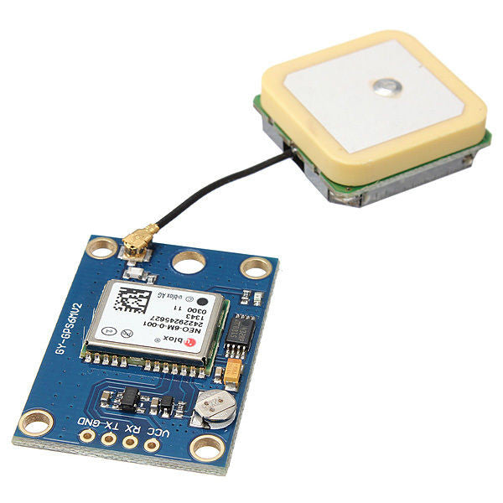
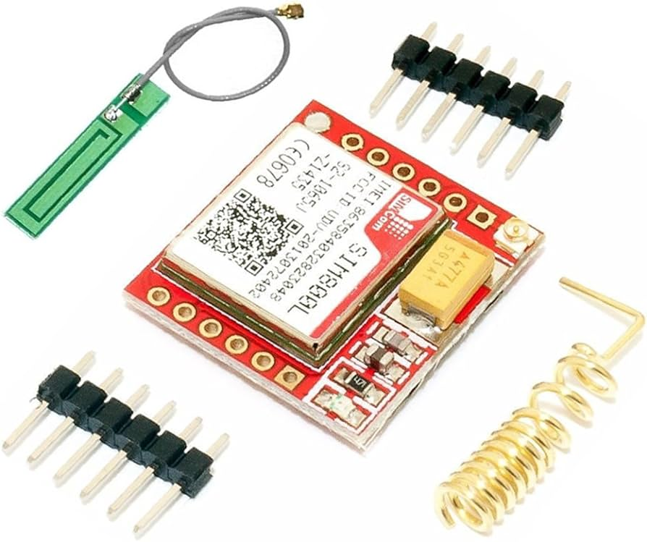
Hardware
Arduino
HC-SR04 Ultrasonic Sensor
GSM SIM800L Module
NEO-6M GPS Module
Notes:
Coming to the hardware, the brain of the system is an Arduino Nano. HC-SR04 is an Ultrasonic sensor which we will be using to detect obstacles. Two core components are the SIM800L and NEO-6M module. SIM800L is an GSM Module and NEO-6M is a GPS module. For output we will be using two LED’s and one buzzer. All of the system is powered by two Lithium Polymer batteries and these batteries are charged by TP4056 charging module. There are also two switches as we have a separate connection to power sim800l, neo6m and the Arduino. The ultrasonic sensors are powered using the 5v output pin from Arduino. In addition to all of this, we also have a button which is used to send an SMS.
Ultrasonic sensor’s sole function is to detect any obstacles. It sends out waves and detects them when they are reflected back. It is able to calculate the distance from an item by calculating the time difference between sending and receiving the wave. We will be using two of them.
SIM800L is a GSM module which is capable of performing different functions like receiving and sending calls and sms along with that we can access the internet with this module. It comes along with an antenna.
NEO-6M is a GPS module. It assists us in retrieving our current location. When it is powered it finds an available satellite, and connects to it. It takes data from 4 satellites at one time to calculate the current location which removes the need of geometric data processing.

Slide 4
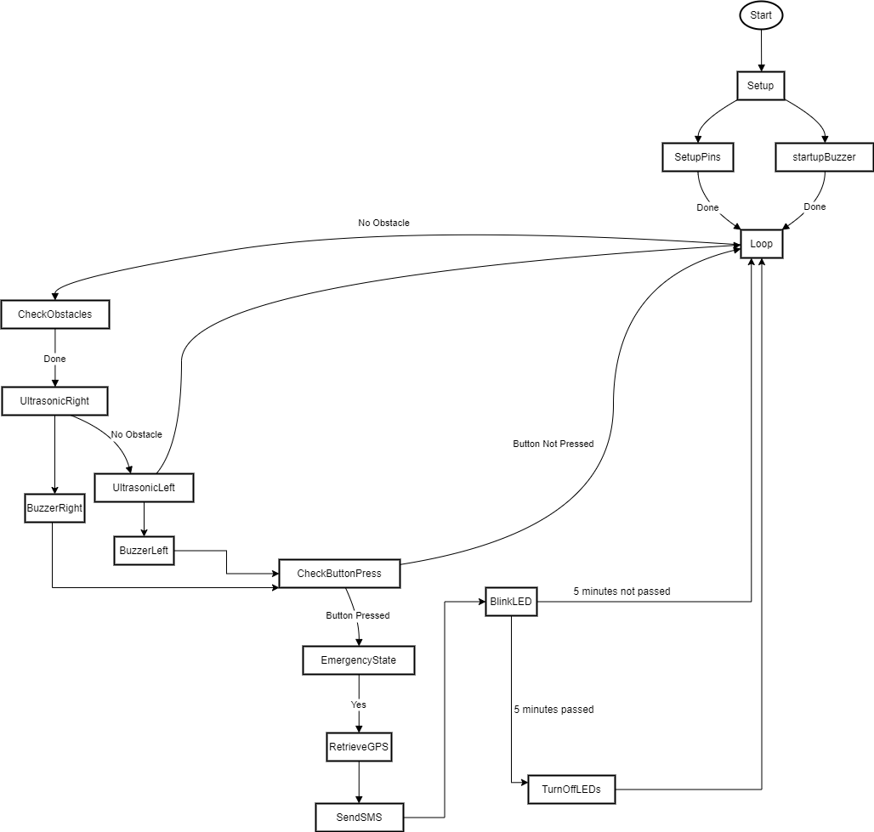
Software
Flowchart
Functions
  Ultrasonic
  Buzzer
  GPS
  sendSMS()
Emergency State
Notes:
We used C Language to code this system. The software we used to code was Arduino IDE. We wanted the code to be simple to understand and also efficient at the same time. We created functions to optimize the code. This would prevent a lot of repetition in the code. Firstly, we declare the SIM800L and NEO-6M pins later in the setup function we setup all the pins these include led,buzzer and ultrasonic pins along with their mode, which are output modes. Then the code goes into the loop function which runs all the time. We call ultrasonic function in which we instruct the sensors to keep detecting obstacles. Once an obstacle is detected at either of the sensors the a specified buzzer function is called so that a specified tone is made relative to distance and sensor. This is normal operation of the stick. If the button is pressed the system goes into emergency state. Initially gps function is called so that the current location can be stored in a variable. Then the gsm module is called so we can pass that variable to the module so that it can send the msg. after that led’s light up which stay on for 5 minutes which is an attempt for visual awareness of emergency to the people around the user.

Slide 5
Testing Strategy
Unit Testing
  Testing each module individually.
2. Functional Testing
  Testing all modules work together
3. Usability Testing
  Testing if the product works as whole properly
Notes:
We had 3 different ways to test throughout the project. Firstly we tested each individual module. We tested HCSR04 by placing an object in the front at different distances. Distance was measure by a measuring tape to check the accuracy which turned out to be pretty good. We tested NEO6M at different locations around the house. It turned out to be very accurate. SIM800L was tested as well in similar fashion. Initially we had to be careful with wiring so we make sure the right pins are connected with each other for all these modules.
Functional Testing was done two times. Once on the breadboard and once after soldering. On breadboard we made sure that the connections work perfectly, it also gave us an opportunity to remove any errors we can in the circuit. The same circuit was replicated onto the Veroboard and we tested if all components are working according the code or not. They worked perfectly.
For usability testing we took the stick out in different places e.g parks and footwalks to test this out. It turned out to be pretty responsive and according to our expectations. This also allowed us to see the real world scenario.

Slide 6
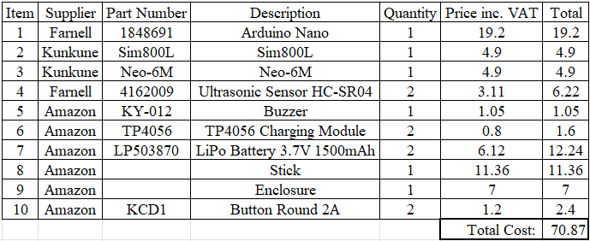
Conclusion
A working smart stick which avoids obstacles
An economical Smart Stick
Smart Stick with Location Tracking in Emergency
An Easy-to-use smart stick
Notes:
Coming to the conclusion we have a working stick which helps avoid obstacle. We were able to keep it very economical around £70 pounds. I hope if this is taken to commercial market we might be able to create this in a much more affordable cost because we will be able to source the components in bulk which obviously would reduce the price along with that getting a component directly from a manufacturer is very cheap compared to a retailer.
Other than that this stick is very easy to use, a person doesn’t require a special training to use this. Other than that the smart stick also gives an option to send current location to dedicated number when in emergency which can prove to be very useful.

